Slide 1

Welcome to DAU

Slide 2
Before I begin…!
Your official email id will be available in 2-3 days.
The credential /details will be posted on your registered email ID

Slide 3
Please send an mail from your
“registered mail id for admission” to help_desk@dau.ac.in with following details.
Name of the student :
Student ID :
Program Name :

Slide 4
REGISTRAR’S OFFICE
Academic and General Administration
Student ID Card
Network Drive \\daiictpdc
ERP
CONTROLLER OF EXAMINATION
Exams at DAU and related topics

Slide 5
Team
Siddharth Swaminarayan
Executive Registrar
Jigar Yagnik,
  Deputy Registrar and Controller of Examination
Jalpesh Pandya,
Deputy Registrar (Academic and Data Depository)
Dinesh Prajapati,
  ERP Administrator and Jt. Controller of Examination
Rahul Prajapati,
  Assistant Registrar
Mahendrasinh Dabhi,
  Senior Executive-Examination
Abhilash Bhaskaran,
  Sr. Secretary in Registrars Office
Jainik Patel,
  Academic Assistant

Slide 6
Academic Administration
Academic matters - admission to graduation+
    maintains student records
    announces semester registrations
    fee payment process
    issue of grade sheets and
    other documentations.
First point of contact (in person assistance):
      Jainik Patel
      Abhilash Bhaskaran
Next level (in person assistance):
      Rahul Prajapati

Slide 7
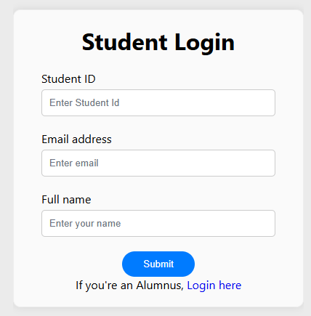
Documents and Certificates
Bonafide Student Certificate
Grade Reports / Transcripts
Fees Structure
DOCUMENTS SERVICE PORTAL
https://documents.daiict.ac.in/student/login

Slide 8
For academic and scholarship matters email to
Academic Administrative issues
  asst_registrar@dau.ac.in
Scholarships
  scholarships@dau.ac.in

Slide 9
General Administration
Security
Food Courts
Campus Maintenance including hostels and Sports Complex
First point of contact:
For General Admin Issues: Kirit Pandya or
Rajesh Patel
For TAship/ Stipend: Gyanesh Pandya
Next: Krutika Raval, (Head, HR and Admin)

Slide 10
Student Identification Card
The fresh students are issued with an identification card in about two to three weeks of registration for the first semester. We will update you about process in due course.

Slide 11
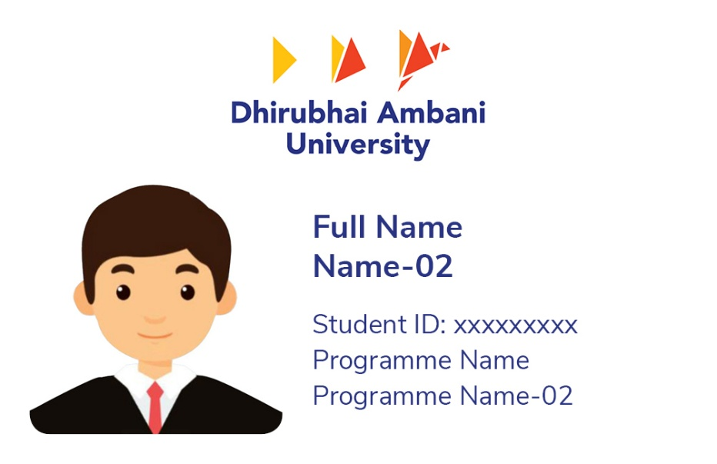
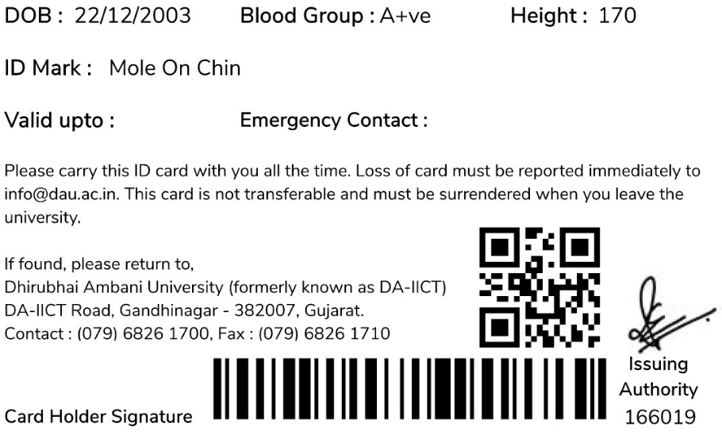
Student ID Cards
Student ID Card front side
Student ID Card back side

Slide 12
DA-IICT PDC
For all rules and regulations and announcements, the students should visit ‘Academic’ and ‘Announcement’ folders of DA-IICT PDC.
To access the network drive from outside, visit intranet.daiict.ac.in

Slide 13
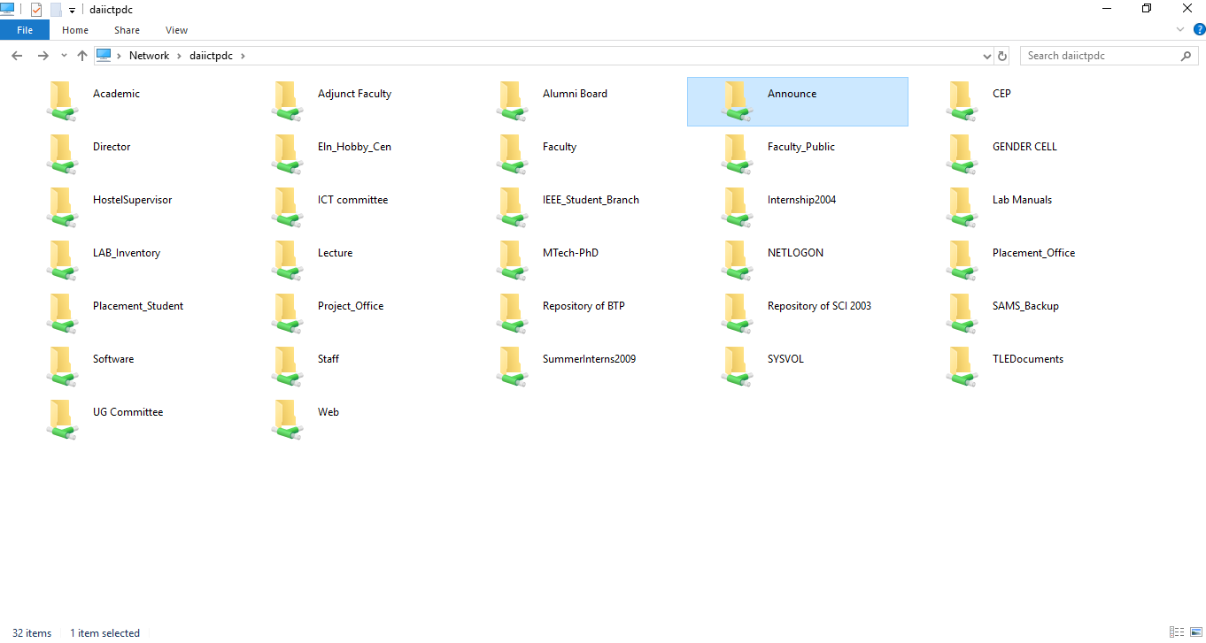
DA-IICT PDC - \\daiictpdc

Slide 14
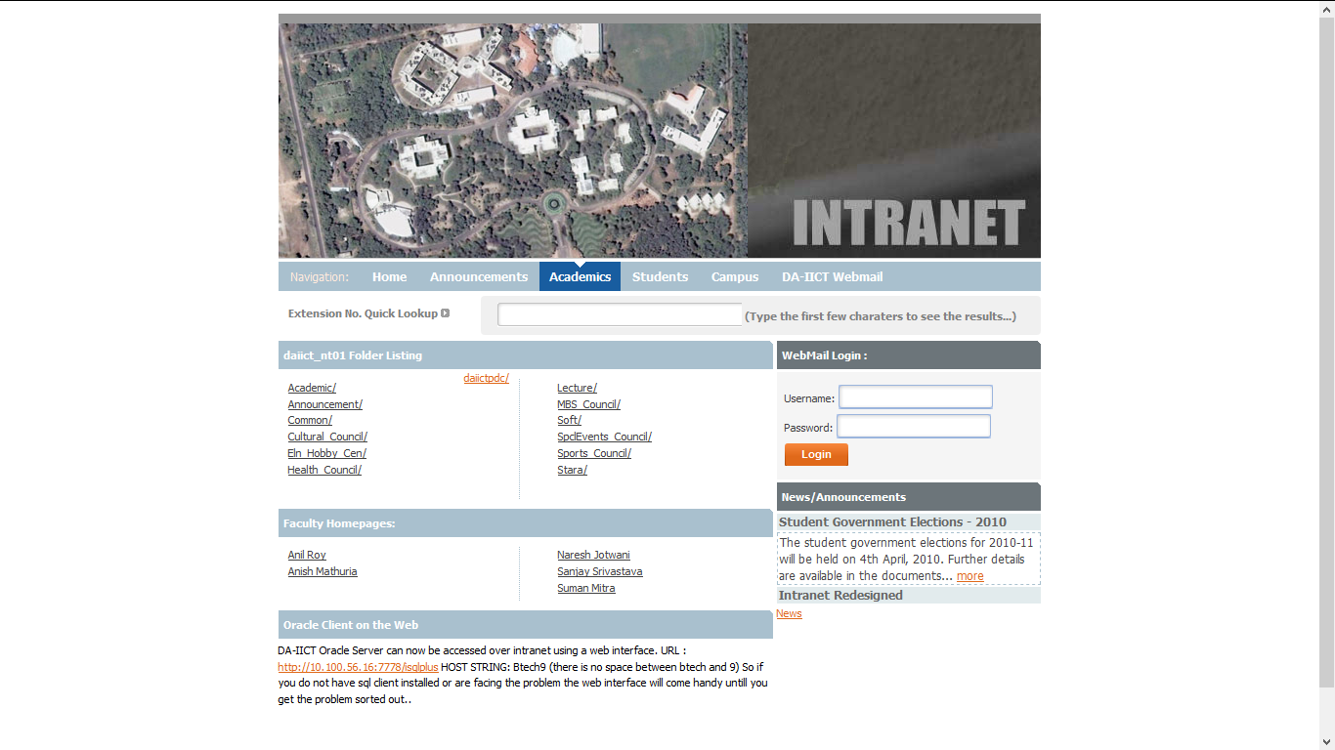
Intranet @ DA-IICT
URL: http://intranet.daiict.ac.in/

Slide 15
http://intranet.daiict.ac.in/~daiict_nt01/Academic/

Slide 16
Registration and ERP
Lets welcome…
Dinesh Prajapati,
ERP Admin & Jt. CoE.

Slide 17
Registration Process
At the end of each semester every student must register for the next semester:
Registration process has two important components:
Registration of Courses
Fees Payment
Registration for courses to be done in ERP system which can be modified during Add/Drop course adjustment period soon after the commencement of classes.
For Registration Query registration_query@dau.ac.in

Slide 18
Fees Payment
Fees payment could be done through ERP using online mode.
The receipts will be available in the ERP at appropriate tab.
If you have log-in related issue for ERP academic_assistant@dau.ac.in
In case of requirement of office stamp on the receipt, one can contact Assistant Registrar along with the print out of the receipt.
For fees related query : fees_query@dau.ac.in

Slide 19
ERP System
The ERP system helps us to manage various institutional activities.
One of the modules in the system is specifically for students.

Slide 20
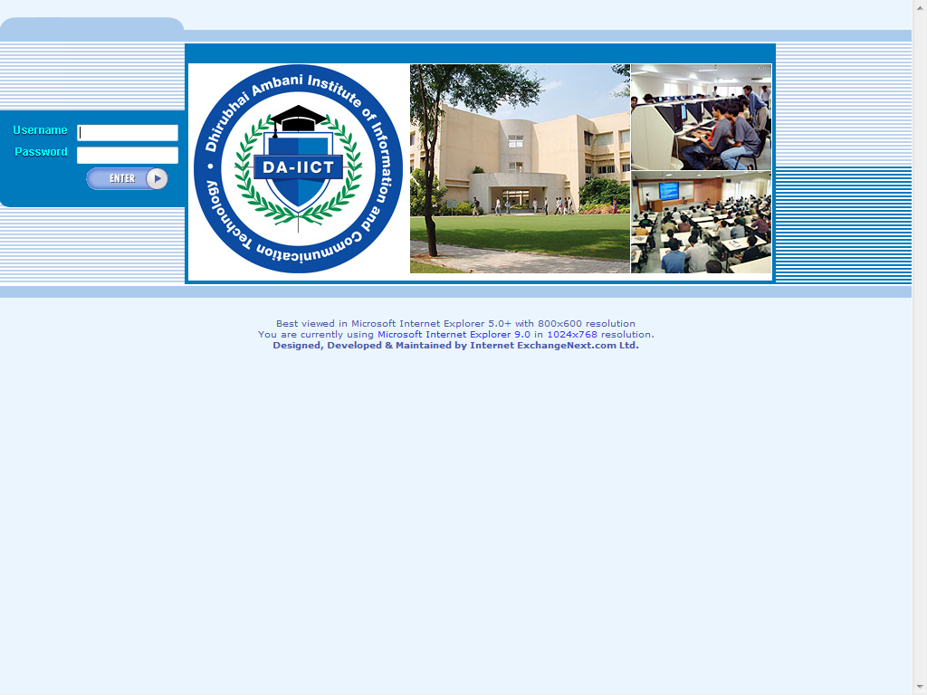
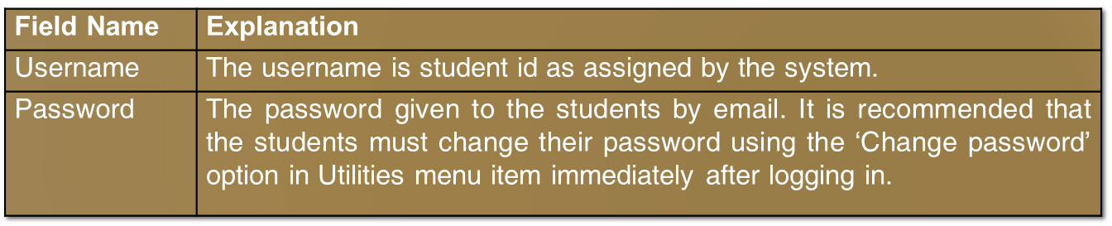
This is the first login screen that one comes across on opening the home page of DA-IICT E-campus, where the students have to enter her/his username and password. This screen then navigates them to the other menu items of DA-IICT.

Slide 21
Once the students are logged in, it will show the welcome page of DA-IICT, which welcomes the students and shows the different menu items which are described below:
Menu Items
Home
Profile
Registration
Adjustments
  Add Course
  Drop Course
Result
Fees
Utilities
  Change Password
Logout

Slide 22
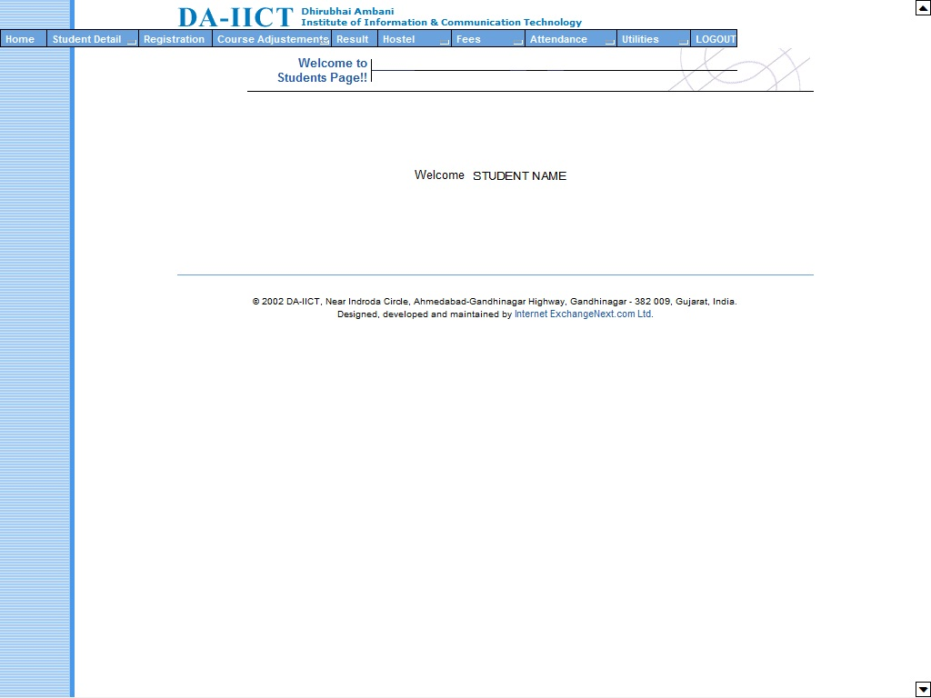
This is the welcome screen that comes after the student have entered her/his username and password. The welcome page of Home menu item welcomes the student in the system. This screen also shows the menu items available to the student.

Slide 23
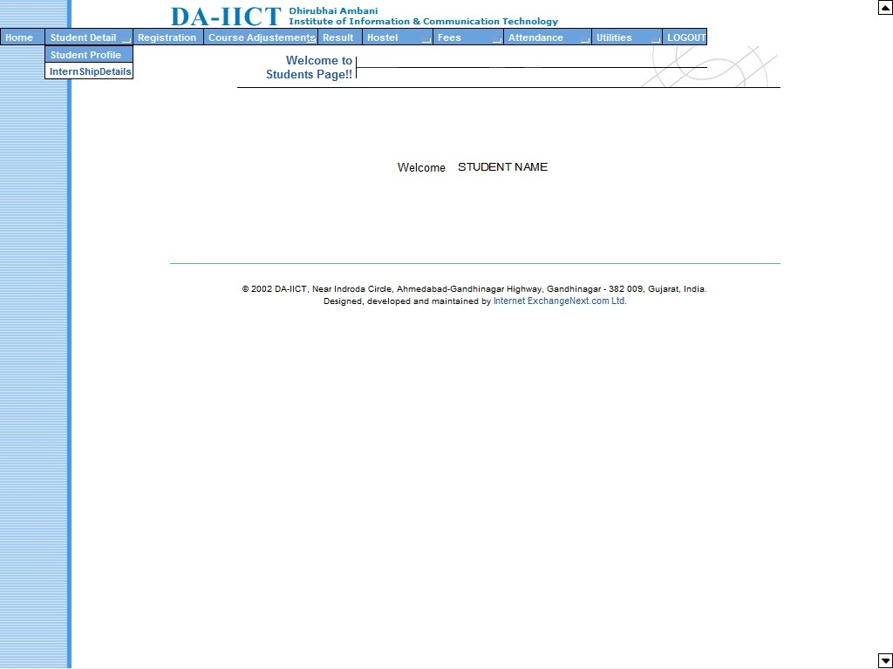
Student Detail – Student Profile
Under this menu item it shows the profile of the student along with their photograph in which it gives the student the option to edit and save the changes made to the different fields.

Slide 24
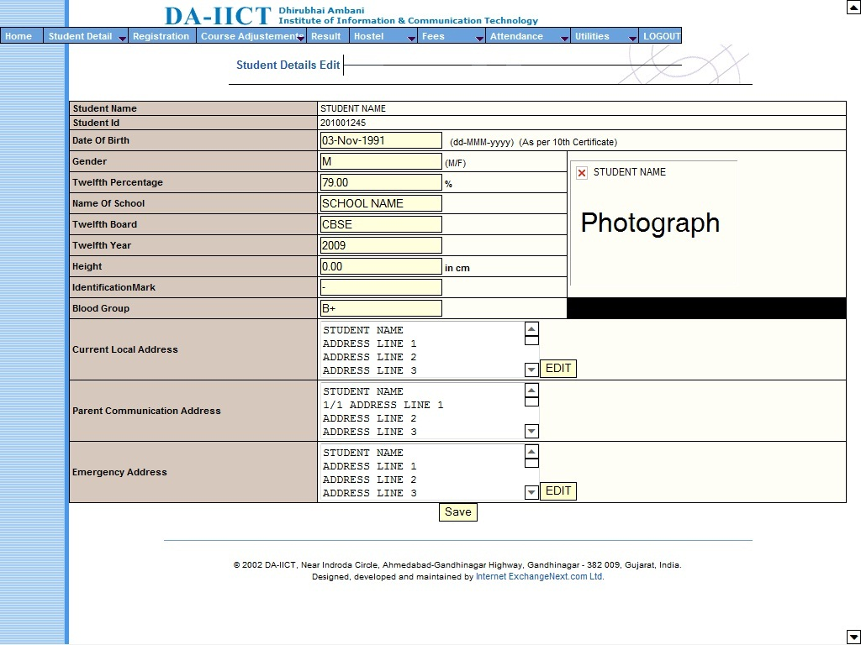

Slide 25
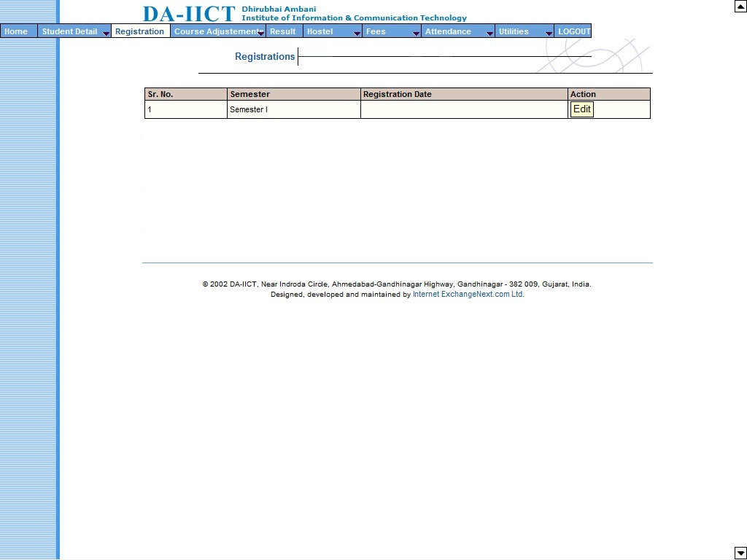
Registration
This is the registration page. It shows the number of semester and the dates of registration. It also gives option to edit the details where they have to enter in the details in a registration form in which the student selects various courses for the semester and then sends it to the UG / PG Convener for approval.

Slide 26
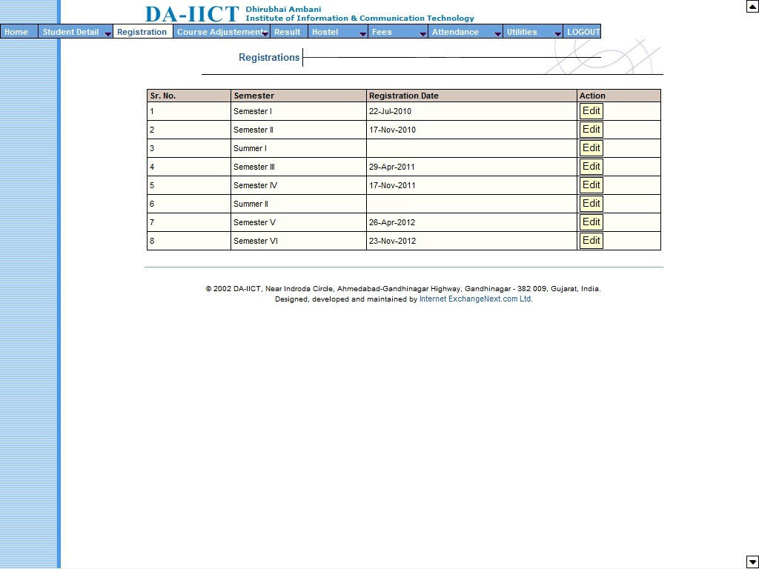
Registration
The date of which the student registered will be reflected in the Registration Date column. The next two slides will show the details visible inside the registration page once the edit button is clicked.

Slide 27
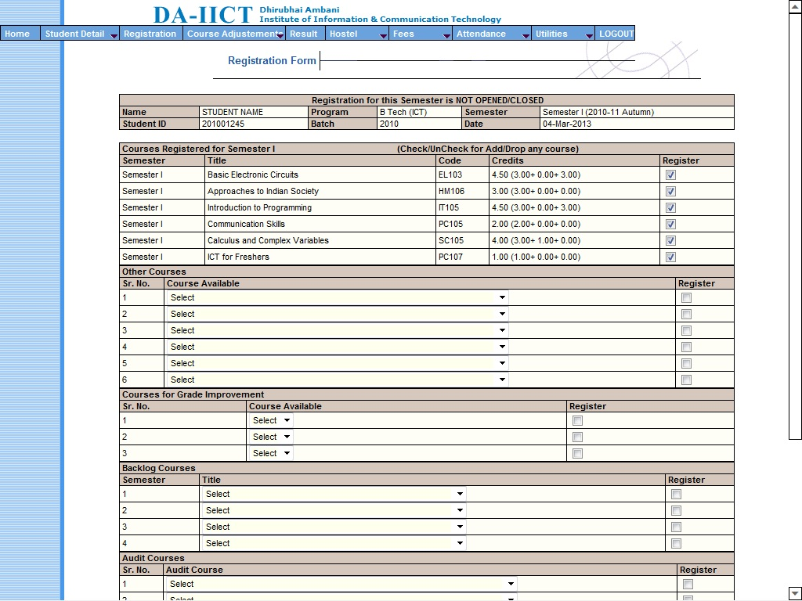

Slide 28
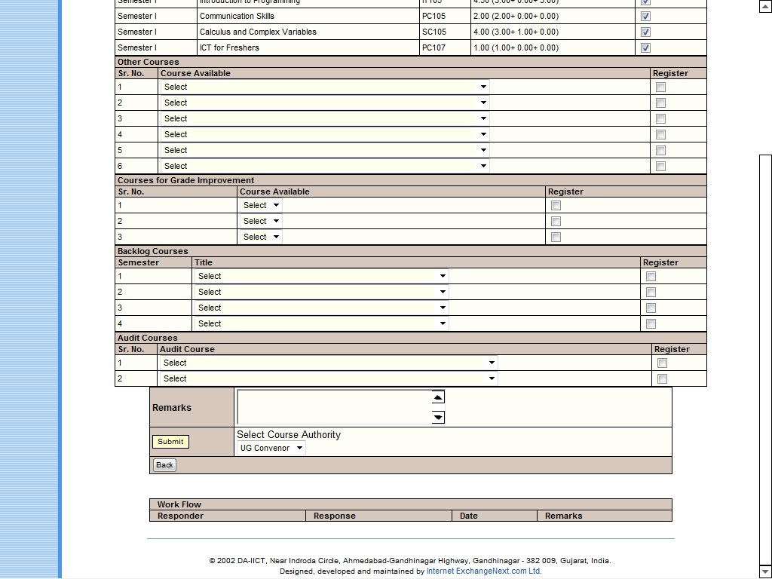

Slide 29
When the student clicks on Edit s/he will see the following:
Field Name | Explanation
Name | Shows the name of the student.
Program | Shows the name of the program in which the student is registered.
Semester | Shows the semester and the term of the program.
Student Id | Shows the id of the student.
Batch | Shows the batch number of the program selected.
Date | Shows the date of registration.
Then it shows the Courses Registered for the Semester, which will have the following fields:
Field Name | Explanation
Semester | Shows the semester of the program.
Title | Gives you the name of the course.
Code | Gives the code of the course.
Credits | Shows the credits earned.
Register | Shows whether the course is active or dropped.
Please note that for the Semester I - IV core courses are already listed and student just needs to tick the checkbox to register and click the submit button.

Slide 30
The Other Courses option will have drop down menu with names of other courses which are available to the student. The student has to select the course of his choice from the drop down menu and select the checkbox under Register field to add the course to the registration.
The Courses for Grade Improvement also has drop down menu with names of the courses available to student to improve his/her grades. Please note that a student is allowed to register the courses for grade improvement only as per the rules mentioned in the Academic Requirements.
Backlog Courses also has drop down menu which shows the courses prescribed by the curriculum, which are either not been registered or failed by a student.
Audit Courses also has drop down menu which shows the courses which are allowed to the students as audit courses as per the guidelines given in the Academic Requirements.
After the necessary selection of courses has been made the student may enter the any remarks which he wants to convey to the approving authorities and click on the submit button. Work flow will show the net results of each step.

Slide 31
The net result can be seen in the Work Flow at the bottom of the Registration screen.
Field Name | Explanation
Responder | Shows the person whom you are sending the information.
Responses | Show the response action.
Date | Shows the date.
Remarks | Shows the remarks for that particular response.
In the work flow in the Response column if responses shows approved than it reflects in Results page that particular semester Grade Card also.
Please note that once the submit button is clicked the student will not be able to edit the registration any more.
Also note that Registration is mandatory for all the students as announced from time to time by the University.

Slide 32
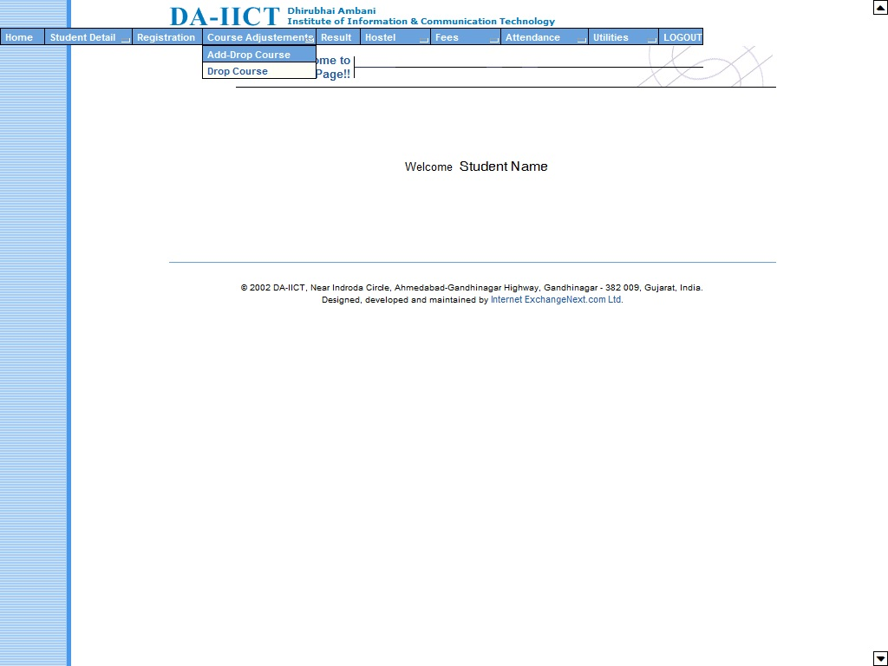
Course Adjustments – Add-Drop Course
A student has an option to add / drop a course as per the schedule announced by the University. After the registration has been approved by the authorities a student can modify the registration during add/drop period.

Slide 33
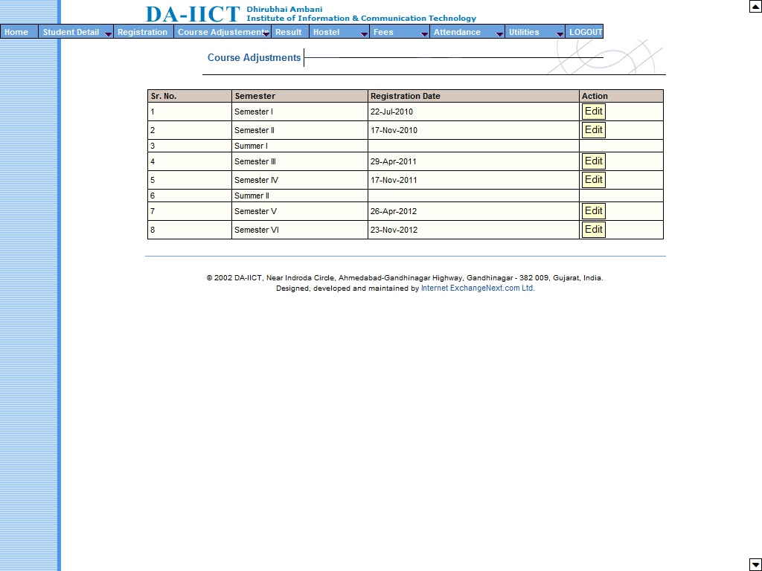
Course Adjustments – Add-Drop Course
Here it shows the student the number of semester and the dates of registration of the program selected by them. Here the student has the option to add or drop the courses as per the electives and edit the same. The procedure and content are similar to the Registration process and workflow is also the same. Changes will be reflected in Results page on approval. Next screen shows the page after approval of course adjustments.

Slide 34
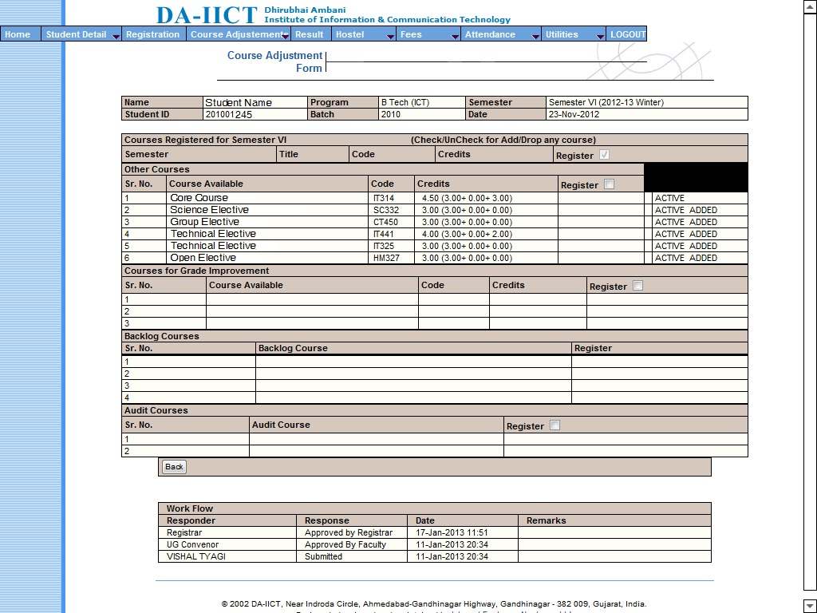

Slide 35
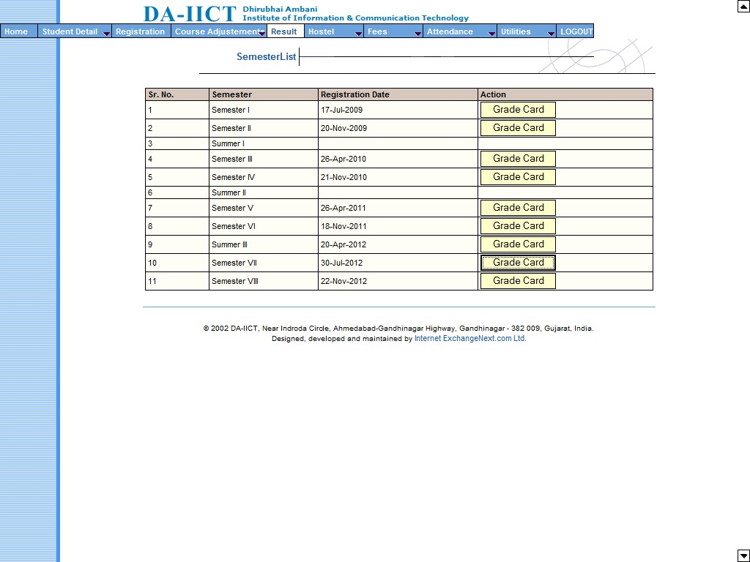
Results
Here the student can see their performance in the grade card that s/he can see under this menu item. This screen shows the student the number of semester and the dates of registration of the program selected by them. Clicking on the Grade Card under Action column will show the grade card of that particular semester.

Slide 36
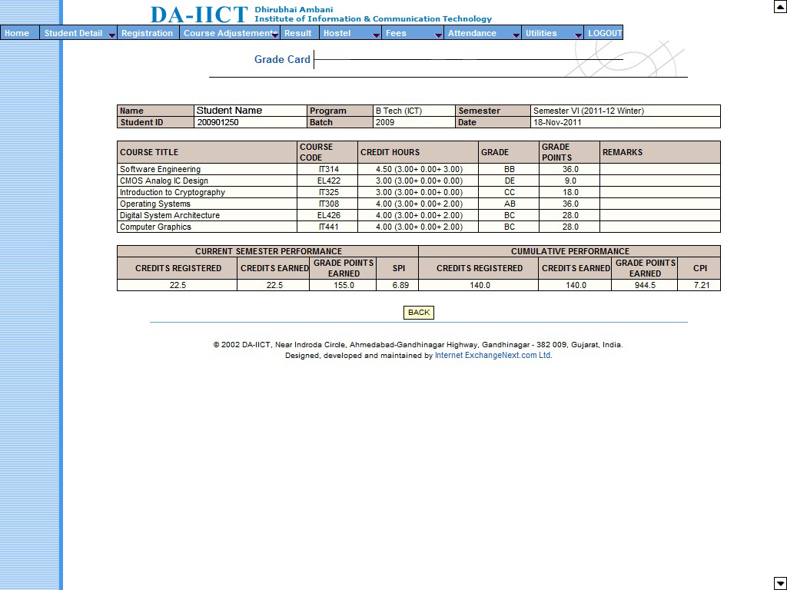
Results
Here the student can see their performance in the grade card which will have the following fields:
Field Name | Explanation
Name | Shows the name of the student.
Student Id | Shows the id of the student.
Program | Shows the name of the program in which the student is registered.
Batch | Shows the batch number of the program selected.
Semester | Shows the semester and the term of the program.
Date | Shows the date of registration.

Slide 37
Then it shows the grades obtained by the students.
Then it shows the Current Semester Performance and the Cumulative Semester Performance that have the following fields:
Field Name | Explanation
Credits Registered | Shows the credits registered for the semester performance.
Credits Earned | Shows the credits earned during the semester.
Grade Points Earned | Shows the grade points earned during the semester.
SPI / CPI | Shows the SPI for current semester performance and CPI for cumulative semester performance.
Then the student can click on Back to return to the home page.
Please note that the courses reflecting in the Grade Card on the results page are final and after approval of registration and course adjustments done by a student.

Slide 38
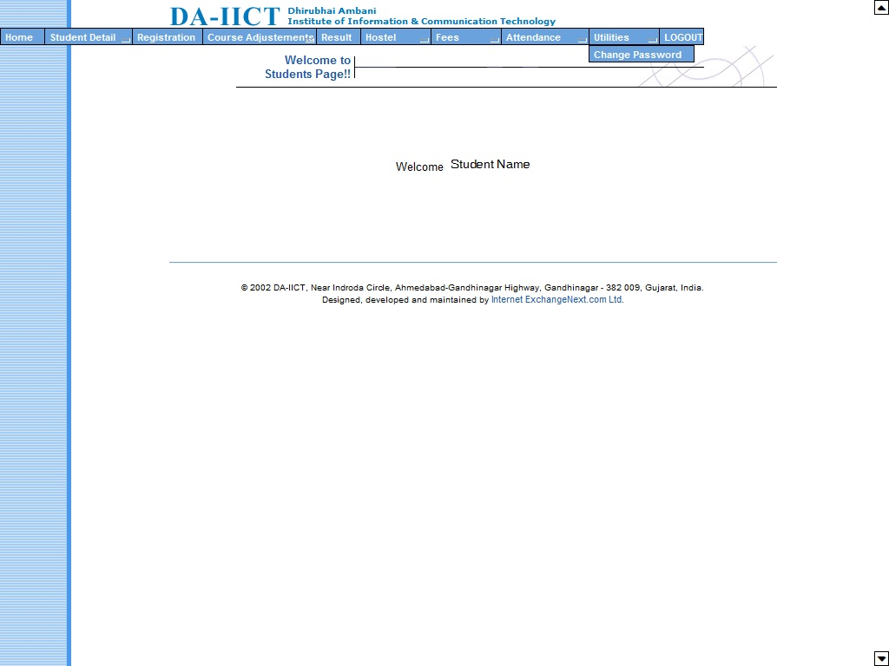
Utilities – Change Password
This is the menu item where the student can change their password. Initially when the student has been given the username and password, s/he has to come to this menu item and change her/his password.

Slide 39
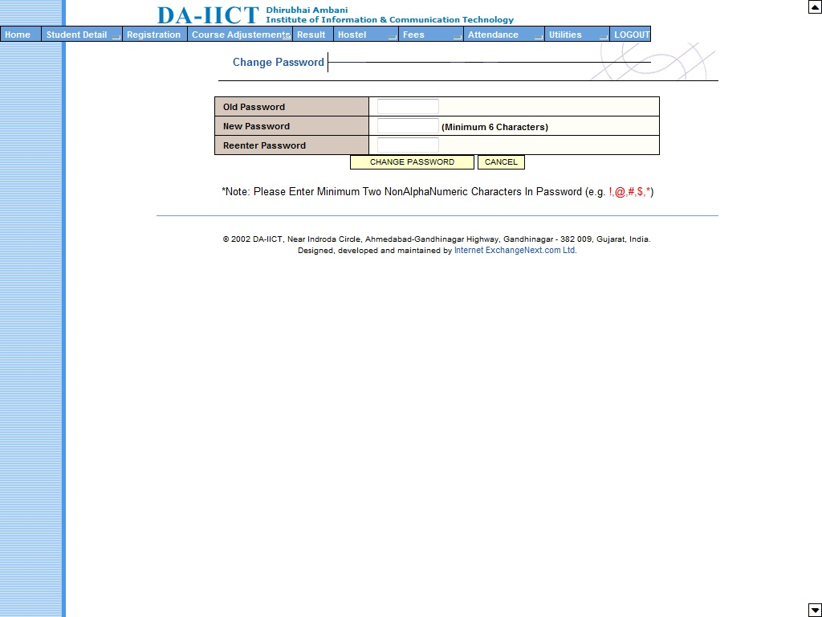
Utilities – Change Password
This screen shows the field require to change the password. First s/he has to put the old password, enter the new password and again reenter enter the new password. Student while changing the password need to carefully read the note given.
Then click on Ok to return to the student home page.

Slide 40
May I now hand it over to…..
Jigar Yagnik, Controller of Examination
for
Presentation on Examination

Slide 41
Controller of Examination

Slide 42
Type of Exams
Oral or Written
Descriptive or Objective
Open book or Closed book
Announced or Surprise
Theory or Practical
.
.
.
and so on!

Slide 43
Exams by CoE
In a semester:
Two In semester Exams – In Sem
One End Semester Exam – End Sem
For Autumn 2025-26 Semester
First In-semester Exam:
20-23 Aug 2025
Second In-semester Exam:
03-07 Oct. 2025
End semester Exam:
21-29 Nov 2025

Slide 44
Mode of exam by COE
Written exams - physically proctored.
Classroom mode

Slide 45
Key Functions of CoE office
Scheduling and notifying exams.
Question paper printing and on time delivery
Invigilation Arrangements
Seating Plan preparation
Conducting exams on time
Strong room operations
Addressing issues including malpractices
Special assistance

Slide 46
Rules related to exams
Please visit intranet.daiict.ac.in and go through following rule books:
Examination Rules for Students
Rules & Guidelines for Conducting written examination for Person with Benchmark Disabilities
Malpractices/ Improper Conduct in Examinations and Consequences

Slide 47
Exam related communications
coe_office@daiict.ac.in

Slide 48
All the best!!
Questions?

